Slide 1
Talking to your patients about MyChart

Slide 2
Why talk about MyChart with our patients?
Giving patients access to their health information online has proven to:
Increase patient satisfaction
Enhance patient care
Improve patient outcomes
Increase resources for patients
Print copies of information
New educational information
Better access to information
Increase communication between providers and patients

Slide 3
Benefits to our patients
Save time! No more waiting on hold to speak to staff or schedule appointments.
It’s convenient! Anywhere, anytime access lets you view your health care information on your time. Including on your smartphone.
It’s private! Secure messaging ensures privacy between you and your physician.
More choices! You have more choices on how you want to communicate to your physician.
Track your health care! Use the portal to track health conditions and chart progress.

Slide 4
Opportunities to talk about MyChart
When they call to set an appointment.
When they call for a refill.
When they call for lab results.
When they call with a question for the nurse or physician.
When a patient calls to pay a bill.
When they schedule a telehealth appointment.
When they arrive for an appointment.
When they checkout after an appointment.

Slide 5
Scenarios
The following scenarios show you how easy it is to talk about MyChart with your patients.

Slide 6
When a patient calls for an appointment
RING…RING
“I’m happy to help you with getting an appointment. Did you know that you can schedule appointments through MyChart?”

Slide 7
When a patient calls for a refill
“I’m happy to help you with your request for a refill. Did you know that you can request refills anytime online through our MyChart patient portal?”

Slide 8
When a patient calls for lab/test results
“Most lab and test results can be found in our MyChart patient portal.
Your lab results, visit summaries, and other important health information can be found on MyChart’s secure site where you can view it 24/7 from your phone, tablet or computer.”

Slide 9
When they call with a question for the nurse or physician
“Did you know that you can now send messages directly to your health care team or provider through our patient portal, MyChart?”

Slide 10
When a patient arrives for an appointment
“For your convenience, you can now make an appointment, see lab results and request refills through our new patient portal, MyChart. It offers so many features to make your life easier. If you’d like, we can get you signed up today. The first step is to complete this short form.”
“This brochure explains how it works. If you have any questions, I’m here to help.”

Slide 11
When a patient calls to pay their bill
“I can certainly help you with that. Did you know you can also pay your bill through MyChart, our patient portal?”

Slide 12
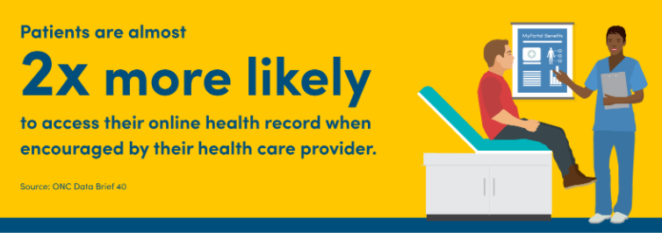
It Takes a Team
Each of us has a responsibility to share the patient benefits of MyChart every time we interact with patients.
Front desk team members, medical assistants, nurses and providers should encourage patients to use MyChart. MyChart makes it easier for patients and the practice alike… but only if the patient signs up.

Slide 13
Not Interested?
Consider handing your patient a MyChart brochure and say:
“MyChart lets you access your health information at any time. This brochure explains all many benefits that MyChart has to offer you and explains how to sign up.
“You can call the number of the MyChart support team and they’ll be happy to help get you started.”

Slide 14
UofL Physicians website
Remind patients if they have questions, they can always visit our website, UofLPhysicians.com.

Slide 15
Don’t forget…
MyChart helps exceed our patients’ expectations
MyChart helps improve the patient experience
MyChart usage allows us to stay competitive in the marketplace

Slide 16
For additional tips or support for MyChart implementation, contact Patient Experience at 502-588-7005 or mychartsupport@uoflhealth.org.
Need additional flyers or brochures? Contact Marketing & Communications at marketing@uoflhealth.org.

